Slide 1
Family Tree.
Oscar Danilo Rivera Moreira
A1-6

Slide 2

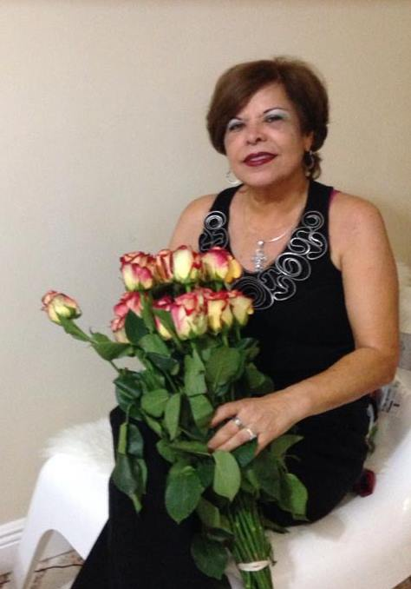

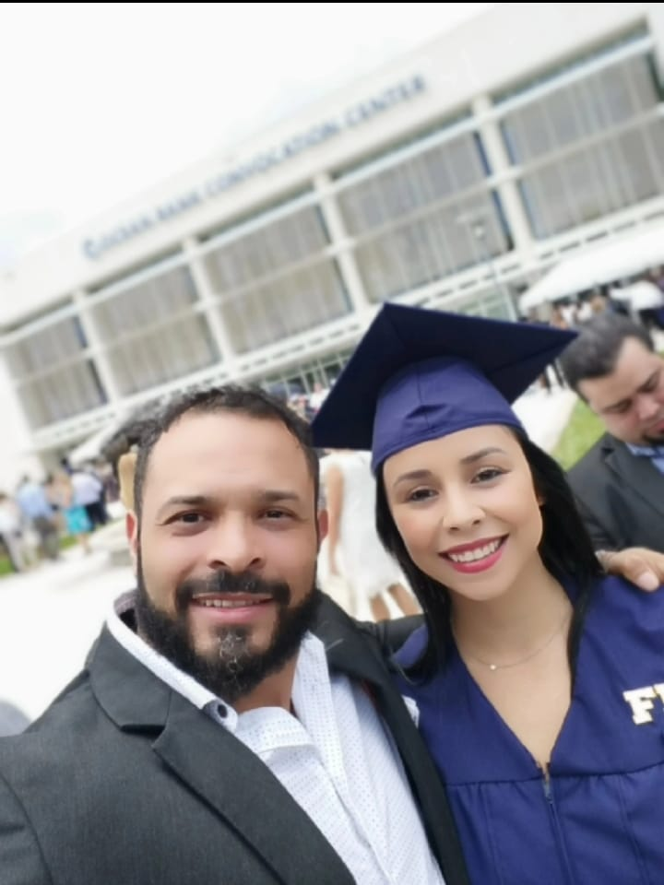
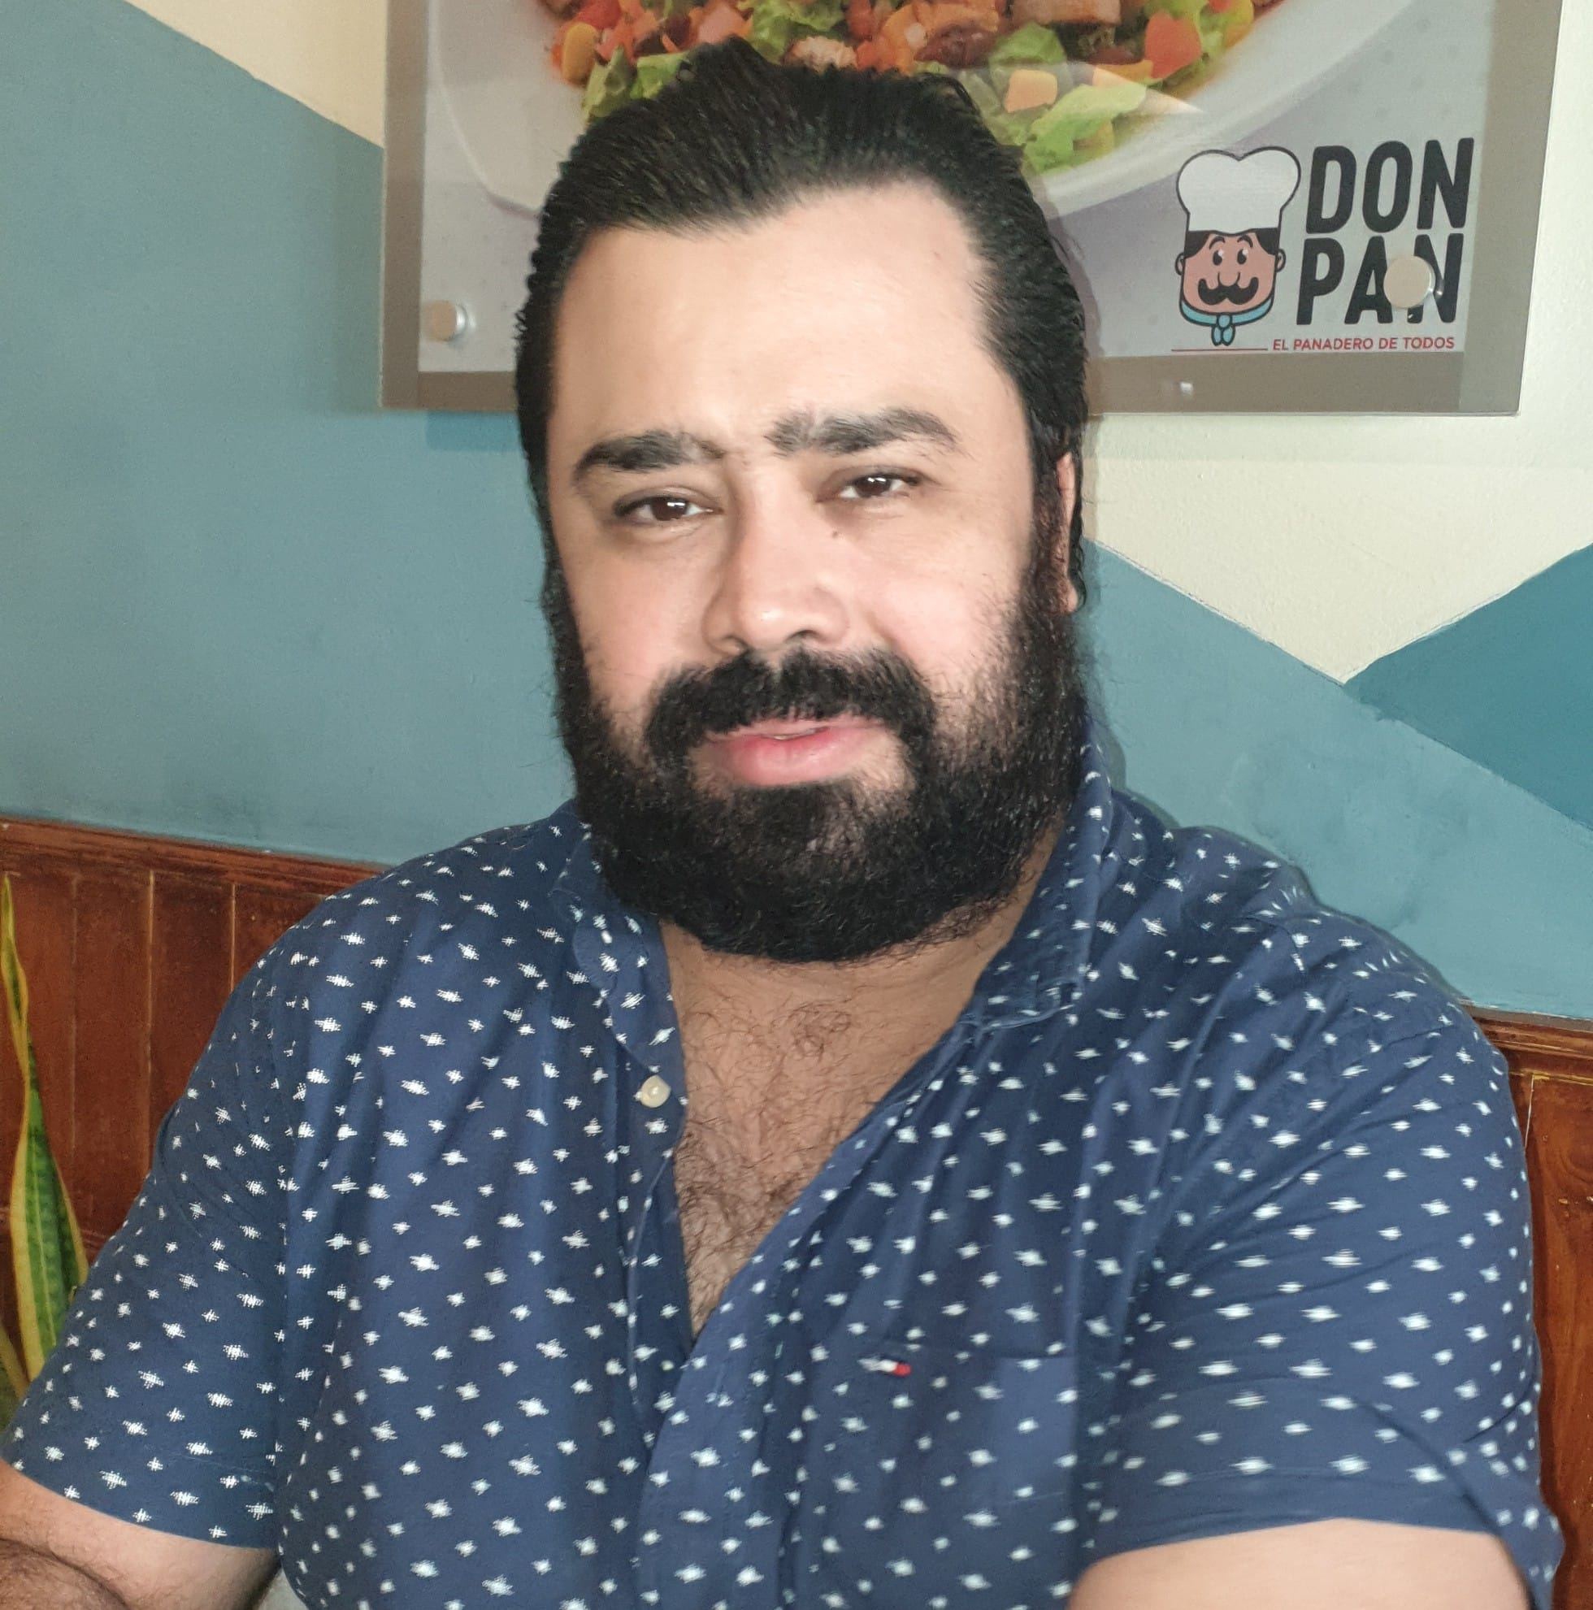
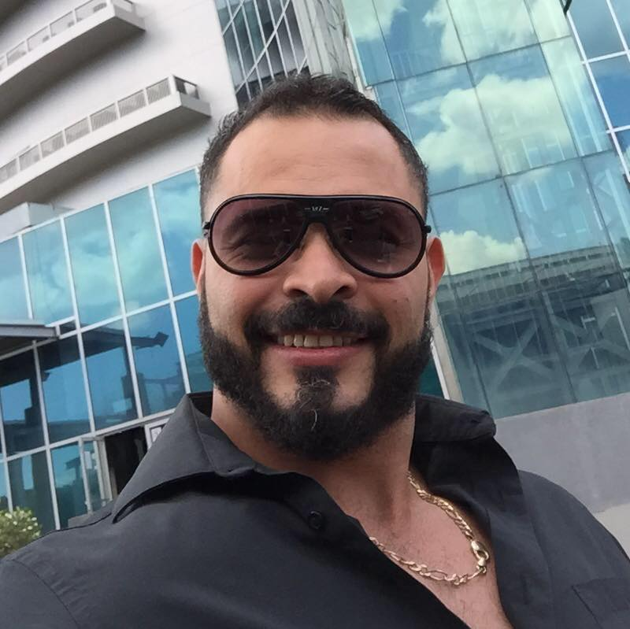
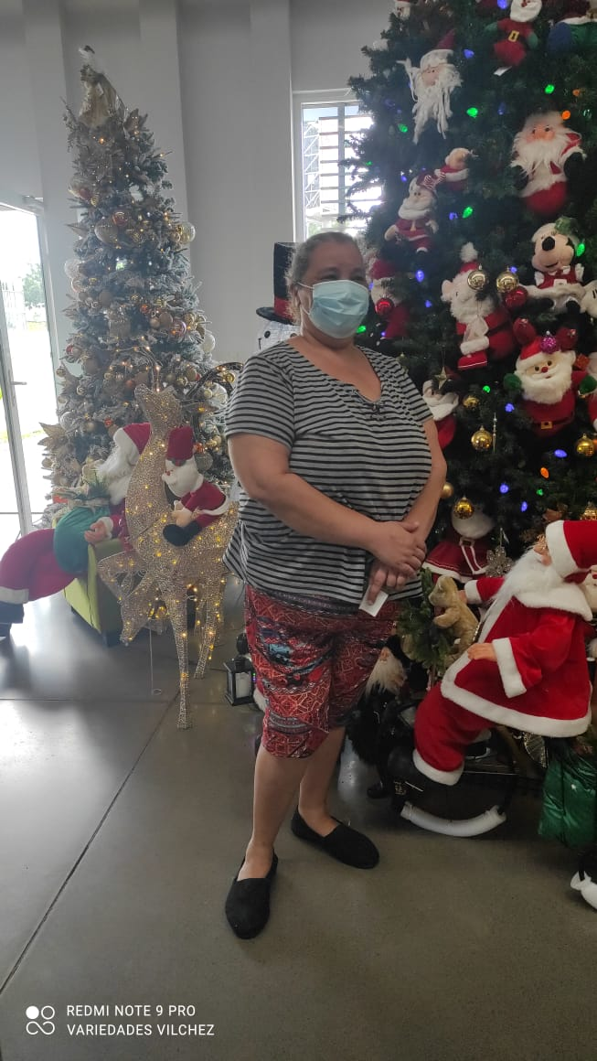
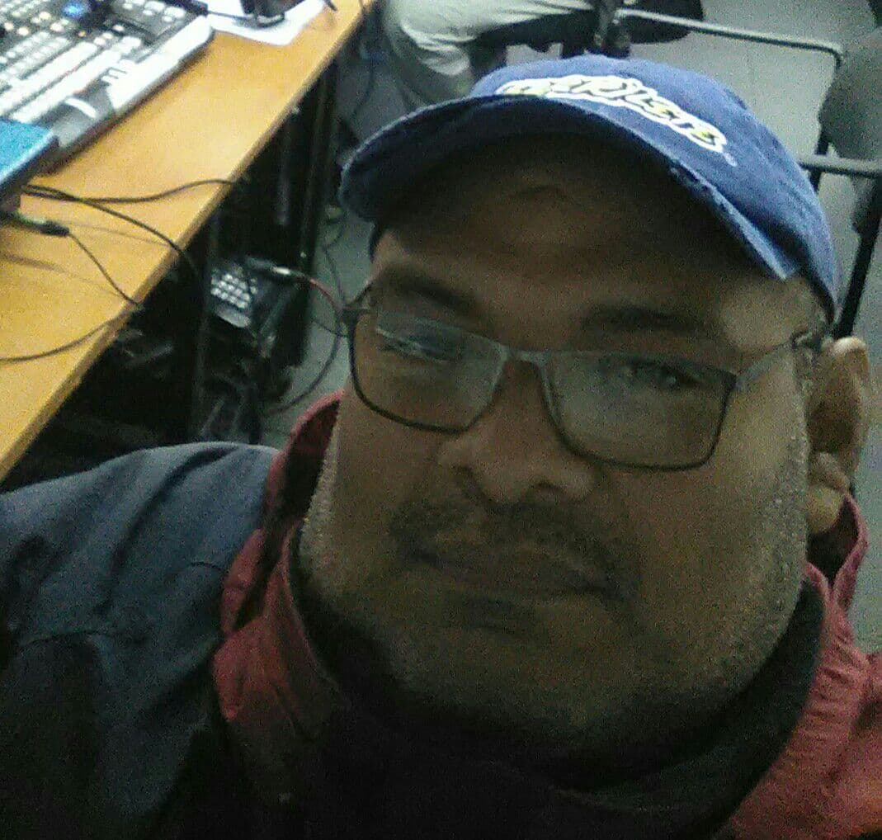
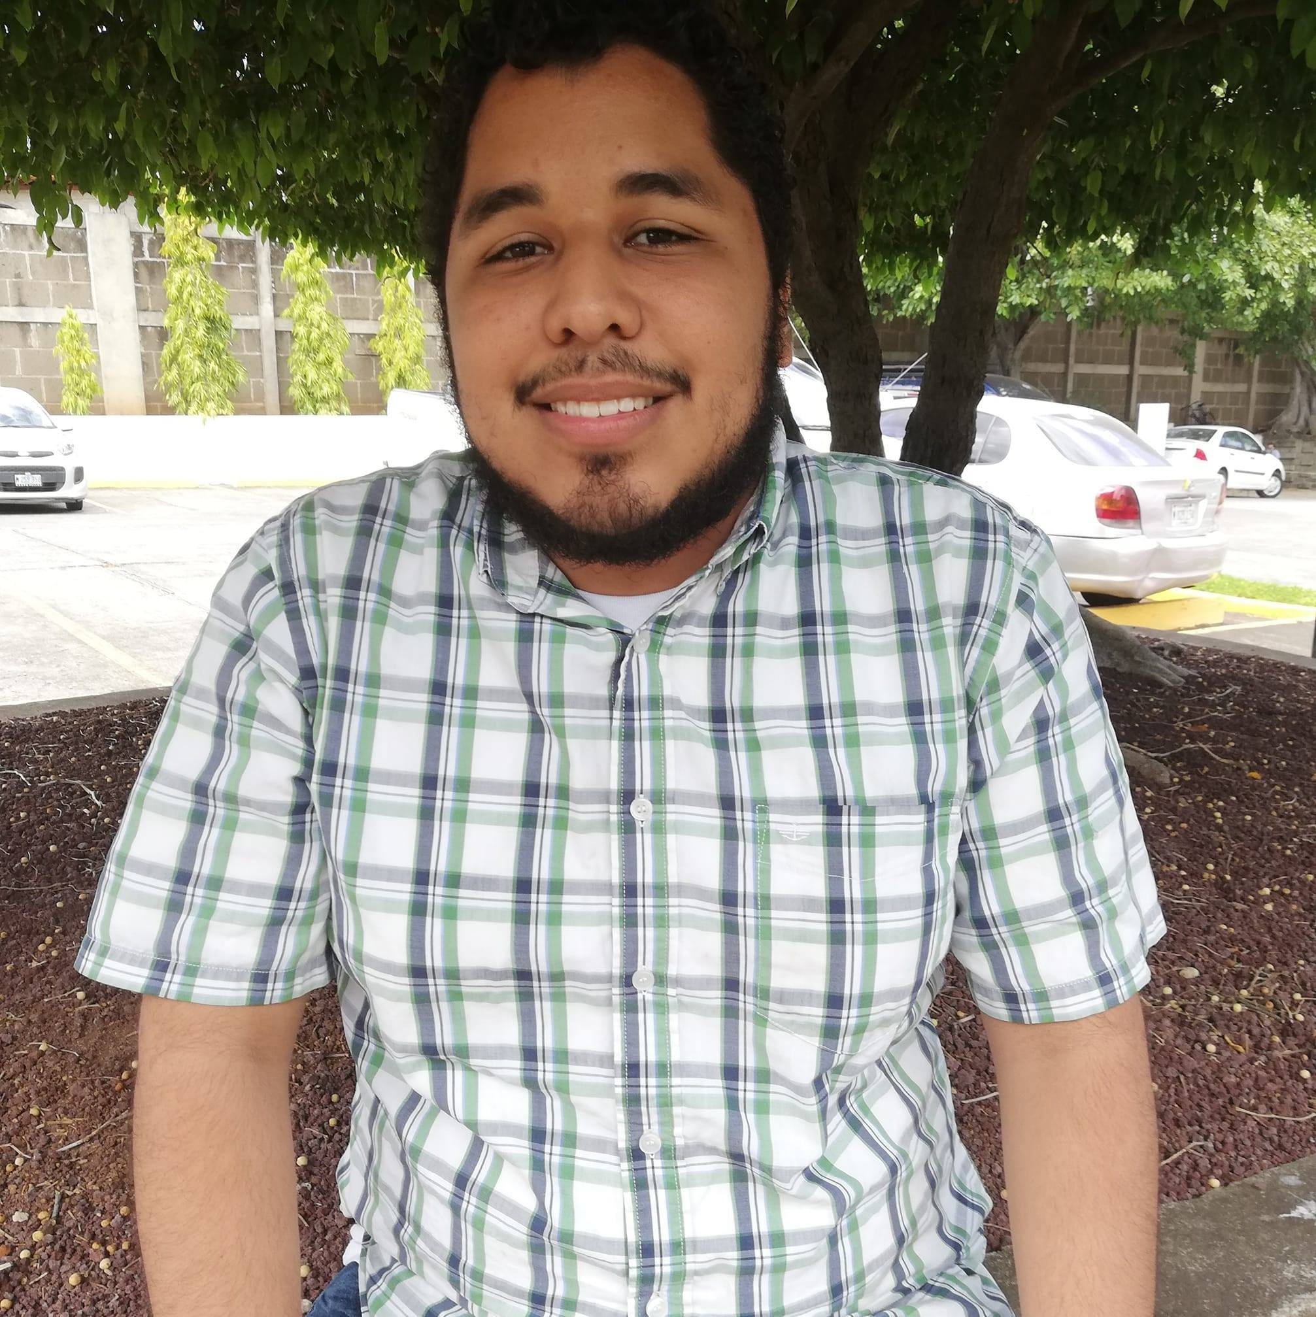
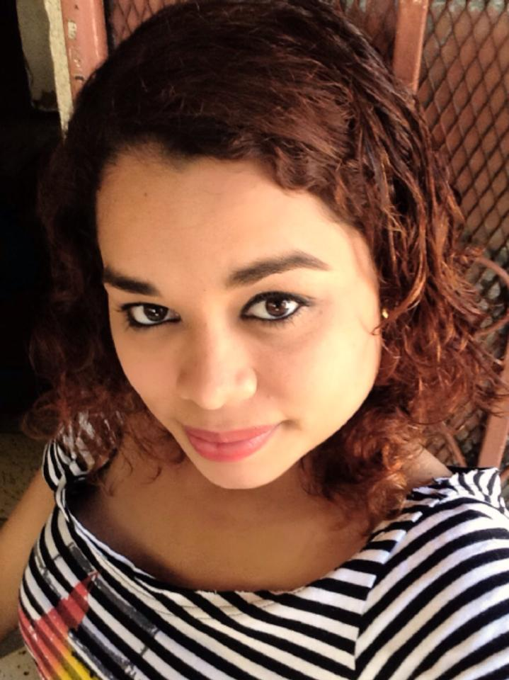
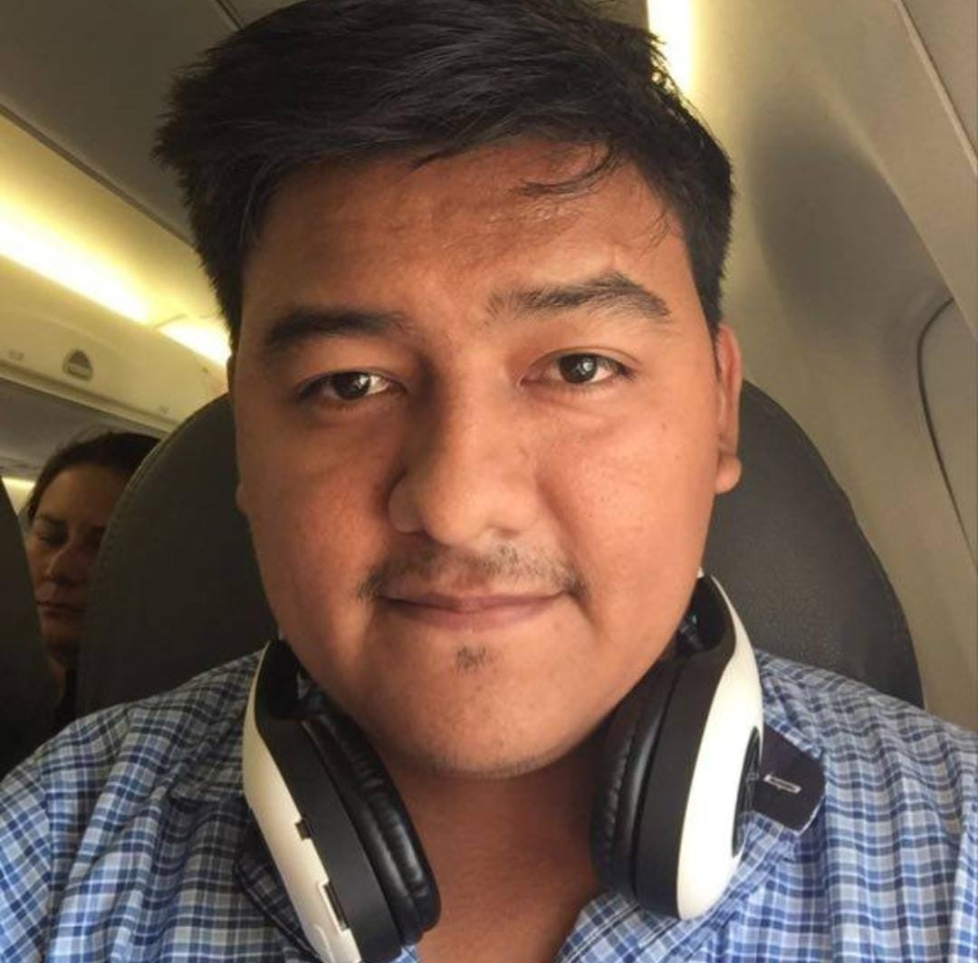
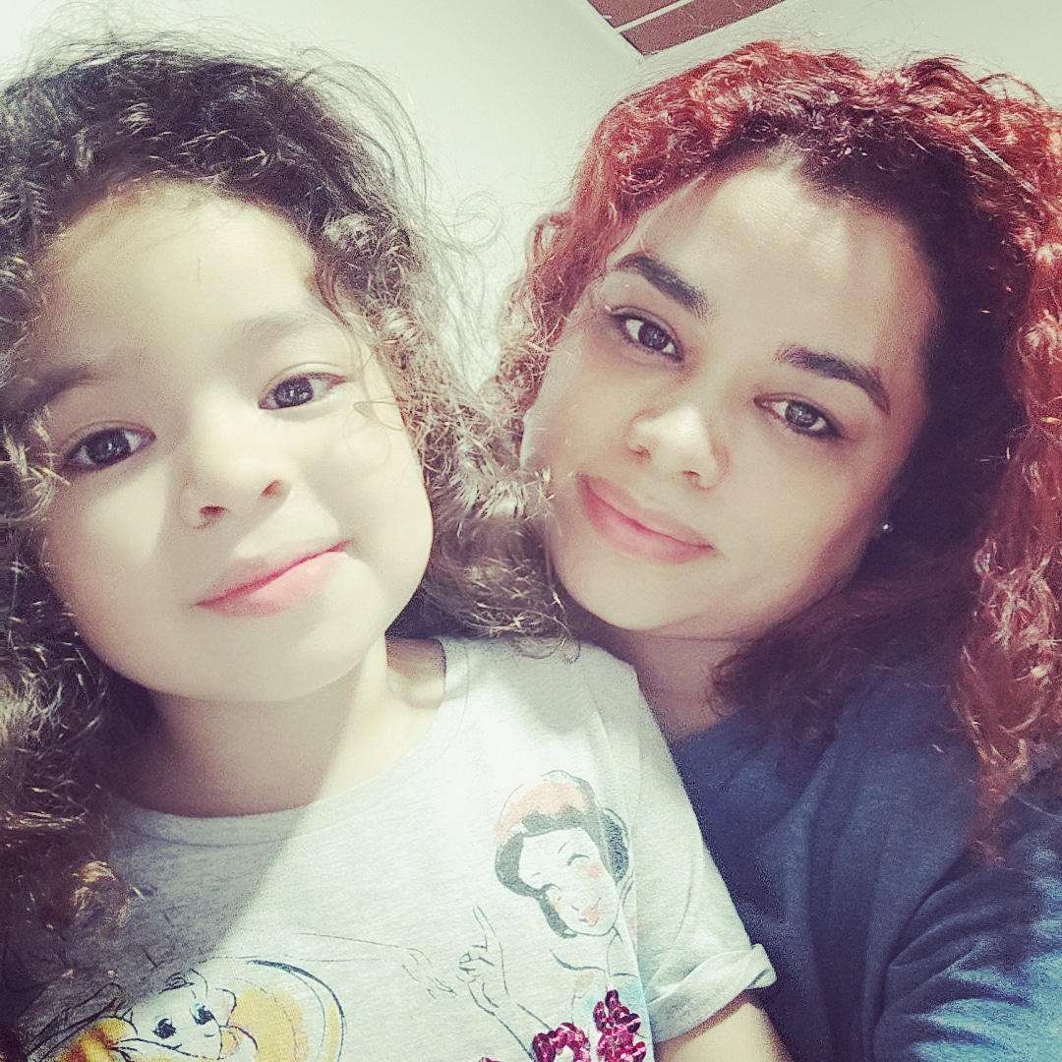
Octavio
Maritza
Jose
Lorena
Frances
Gabriela
Hafner
Elksner
Johana
Oscar
Josue
Mauricio
Oscar
Johana
Carolina
Notes:
https://unsplash.com/photos/rDEOVtE7vOs
https://images.unsplash.com/photo-1507003211169-0a1dd7228f2d?ixlib=rb-1.2.1&q=85&fm=jpg&crop=entropy&cs=srgb&dl=joseph-gonzalez-iFgRcqHznqg-unsplash.jpg

Slide 3
Thank You

